Slide 1
HARP: Home Automation with Raspberry Pi
Joe Danz
Alex Manaila
Michael Muller
Fady Putrus
Stephen Thai
Graham Walker

Slide 2
Sprint #2 Accomplishments
Completed design setup for all UI/UX
Completed dev work for all UI/UX
HTML, CSS, Javascript
Completed dev work to make UI resizable (mobile compatible)
Completed ERD and created the database locally
Completed user login and validation with PHP
Completed user account creation
Completed support of error messages
Completed communication between python script and database

Slide 3
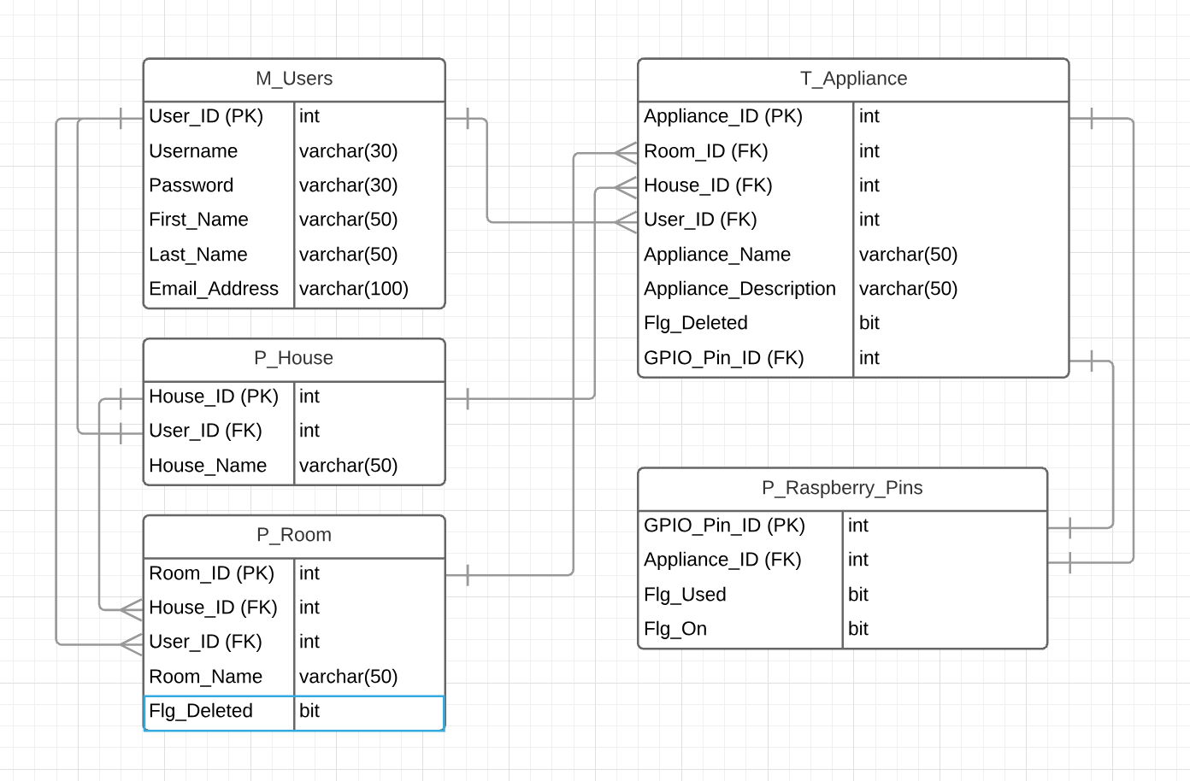
ERD

Slide 4
Sprint #3 User Stories
Required:
As a user, I want the web page to read the state of appliances
As a user, I want the web page to dynamically add the appliances associated with my account
As a user, I want the web page to be able to control appliances
As a user, I want logging out to turn off all appliances
Stretch Goals:
As a user, I want to be able to add appliances

Slide 5
QA Test Cases of Sprint #2
UI/UX should allow navigation between pages
UI/UX should be entirely resizable (mobile compatible)
On/Off buttons should change class and text on click
PHP should allow connection between UI/UX and database
User should be able to login with credentials
User should not be able to access main page without login
User should be able to create a new account
Python script should check database changes every X seconds

Slide 6
Demo

